Slide 1
Spring Ribbon
Load Balancing

Slide 2


Slide 3
Objective
By the end of this 30 minute session you will be able to balance the load between Microservice instances with Ribbon.

Slide 4
Needs / Benefits
This is a large portion of the modern Microservices Framework
Know the function of each
Know how to use them

Slide 5
Starting Multiple Instances of a Microservice
Environment Setup
What is Ribbon?
Connecting Client to Ribbon

Slide 6
Environment Setup

Slide 7
Git clone https://github.com/Cognizant-FSE/petclinic-ribbon-starter
Create Owner, Pet, Vet, Visit databases
Run config-server
Run All 4 Microservices, starting with Owner
Run petclinic-rest-client to populate database
(if continuing from Feign deck, continue to use current project, no changes necessary)

Slide 8
Ribbon

Slide 9
What does Ribbon Do?
Round robin load balancing between available Microservices. Institute Ribbon by:
1. Starting multiple instances of a service
2. Informs client of those URLS
Directs client to use them equally
Notes:
Client here refers to the OTHER microservices that are consuming from the multiple running instances.

Slide 10
Starting Multiple Instances of MS

Slide 11
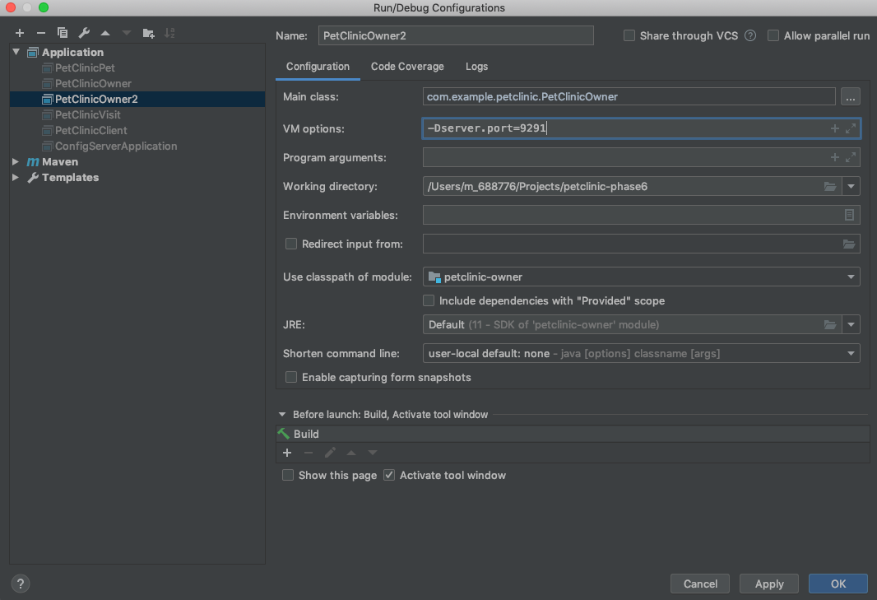
Multiple Running Instances in IntelliJ
Add New
Create Identical Run Configurations except for
VM option specifying a different port

Slide 12

Multiple Running Instances in IntelliJ
Run First Instance
Run 2nd Instance

Slide 13
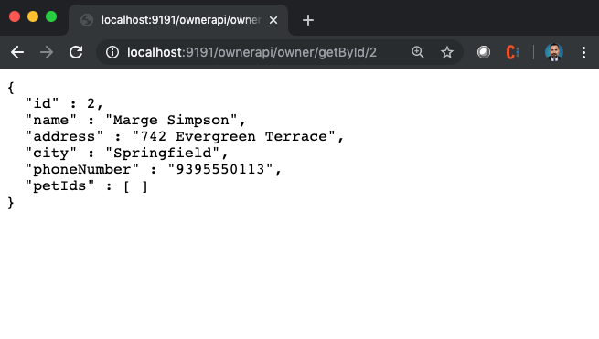
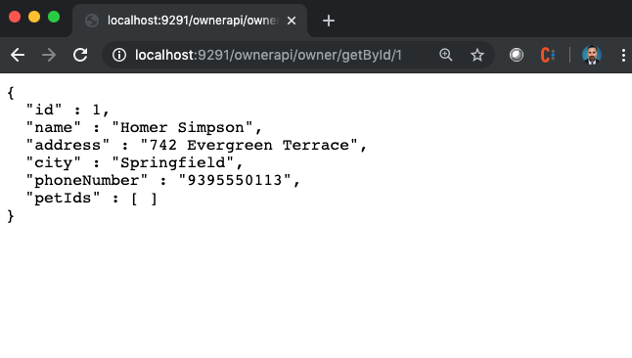
Multiple Running Instances in IntelliJ
Verify Both Are Running

Slide 14
Setting Up Client to Use Ribbon

Slide 15
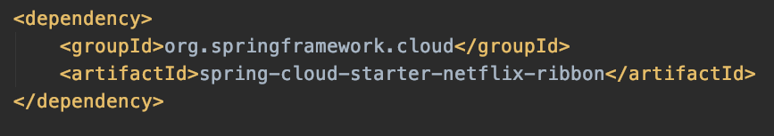
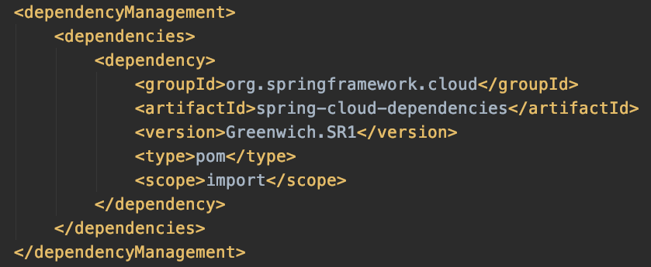
Set Up Client to Use Ribbon
Maven
Should already be inside PetClinicPet pom.xml
spring-cloud-starter-netflix-ribbon

Slide 16
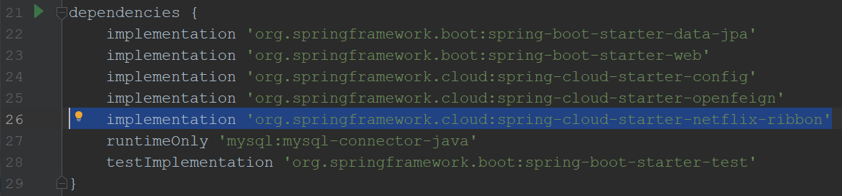
Set Up Client to Use Ribbon
build.gradle
spring-cloud-starter-netflix-ribbon

Slide 17
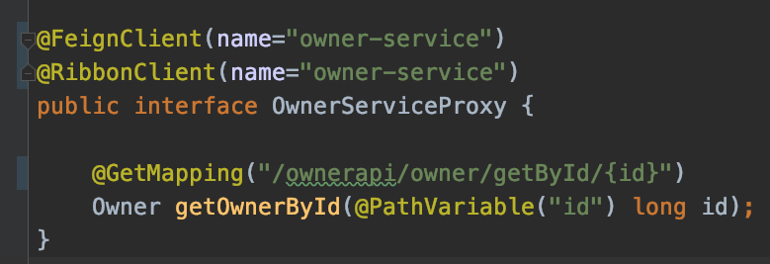
Set Up Client to Use Ribbon
Annotate with @RibbonClient
Remove hard-coded URL from FeignClient
Get mapping must be full path from base

Slide 18
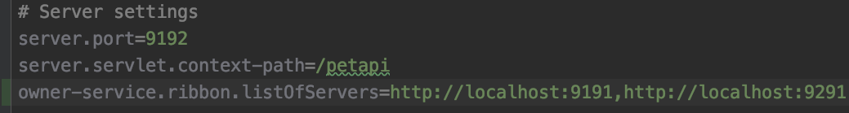
Set Up Client to Use Ribbon
Provide list of servers
!!ONLY BASE ROUTE!!
Must match app name / name in @FeignClient and @RibbonClient annotations
The rest is .ribbon.listOfServers

Slide 19
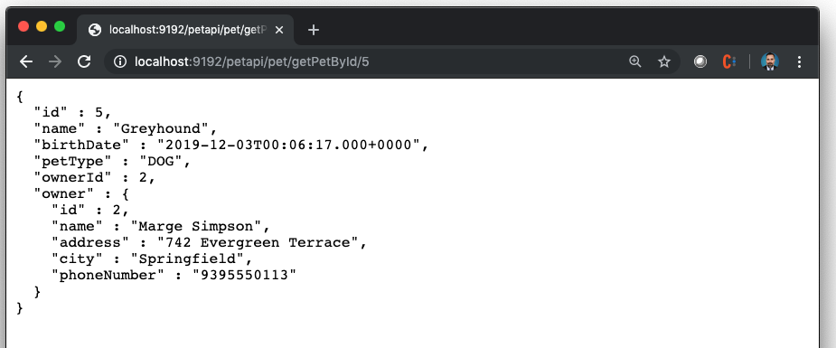
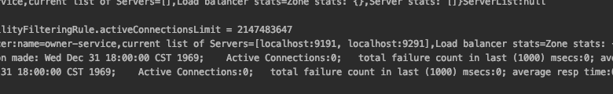
Run Client App and Check Endpoint that Consumes Other Microservices
Notice use of Load Balancing in Spring console
Notes:
If you want to see which port is answering on any given call, you could add a port property to the Song-service Song Bean, then set this value in the controller method that is being called with (Environment.getProperty(“local.server.port”)).

Slide 20
Review
Environment Setup
What is Ribbon?
Starting Multiple Instances of a Microservice
Connecting Client to Ribbon

Slide 21
Objective
By the end of this 45 minute session you will be able to balance the load between Microservice instances with Ribbon.

Slide 22
What annotation is used to connect your Feign interface to the Ribbon?

Slide 24
Jason Monroe
688776

